Slide 1
Predicting NHL Playoff Success
Christopher Manley
General Assembly DSI-5
October 23, 2018

Slide 2
Why Are We Here?
“In 2015, Americans bet $149 billion illegally on sporting events.”
- http://www.visualcapitalist.com/americas-multi-billion-dollar-sports-betting-industry/
Sports gambling laws are changing
Hockey analytics is behind other sports like baseball and basketball, but that is changing fast!
A good and accurate model would be highly
useful to an NHL team
But mostly, I love hockey!

Slide 3
What is the problem?
Problem Statement:
- Given regular season statistics, can a classification model be built to predict how each team will do in the playoffs?

Slide 4
Challenges?
What, in fact am I predicting? And how am I doing so?
Data Gathering

Slide 5
The Data
Source: hockey-reference.com
Scraped regular season team and individual player statistics from 2008-2018 using BeautifulSoup
Single biggest challenge was getting the data into a usable form.
Small amount of data per year. Only 30 real “observations” per year.
Full 10 year dataset is only 331 rows

Slide 6
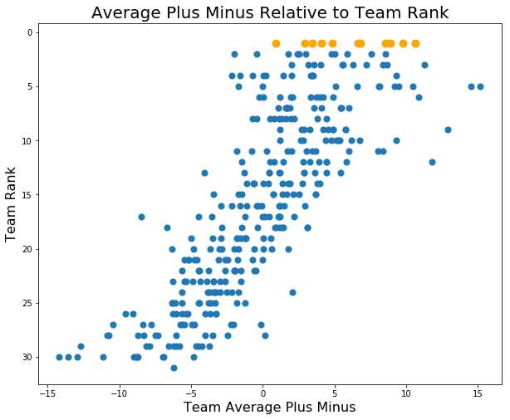
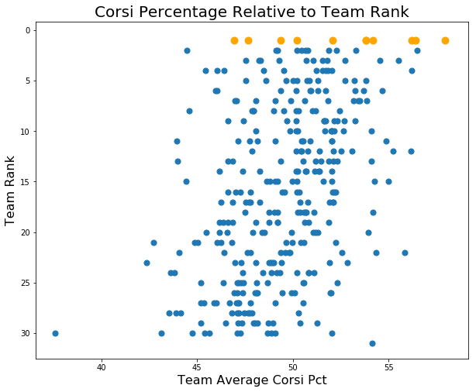
Exploratory Data Analysis
Stanley Cup winners are shown in orange

Slide 7
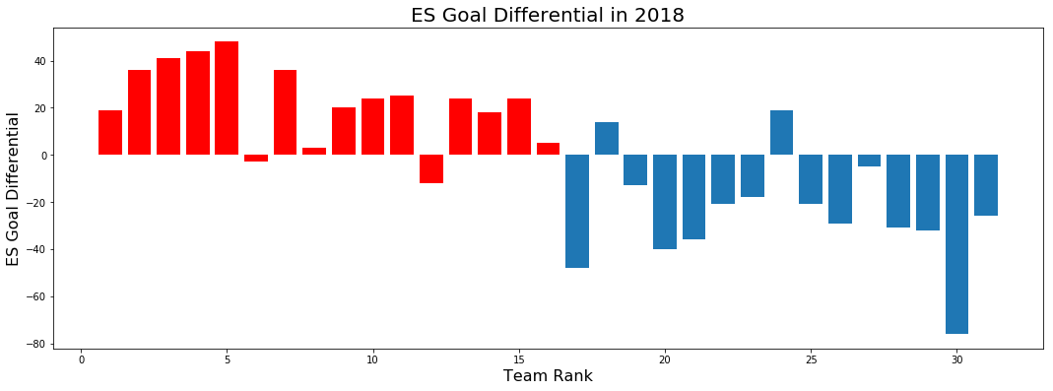
Goal Differential
Playoff teams in red

Slide 8
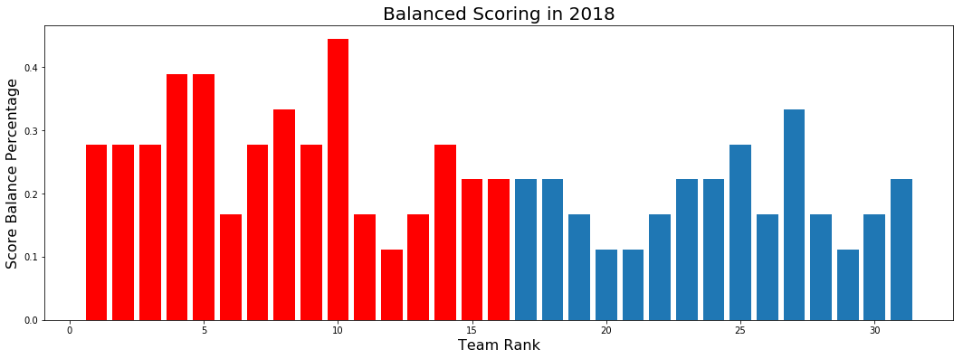
Stats I Made Up
Playoff teams in red
Percentage of a given teams skaters (forwards and defensemen) who are “high scorers.” High scorers are defined as any player who had points higher than one standard deviation above the mean for a given season. The idea is to measure balanced scoring, or depth.

Slide 9
Analysis
Many statistics are good at predicting who will make the playoffs. It is much more difficult to predict how a team will do once they are in the playoffs.

Slide 10
The Model
Multiclass Logistic Regression
- Predicting 30 outcomes for each season
- Accuracy score of…wait for it… (.12)!
- But, it’s not as bad as it sounds

Slide 11
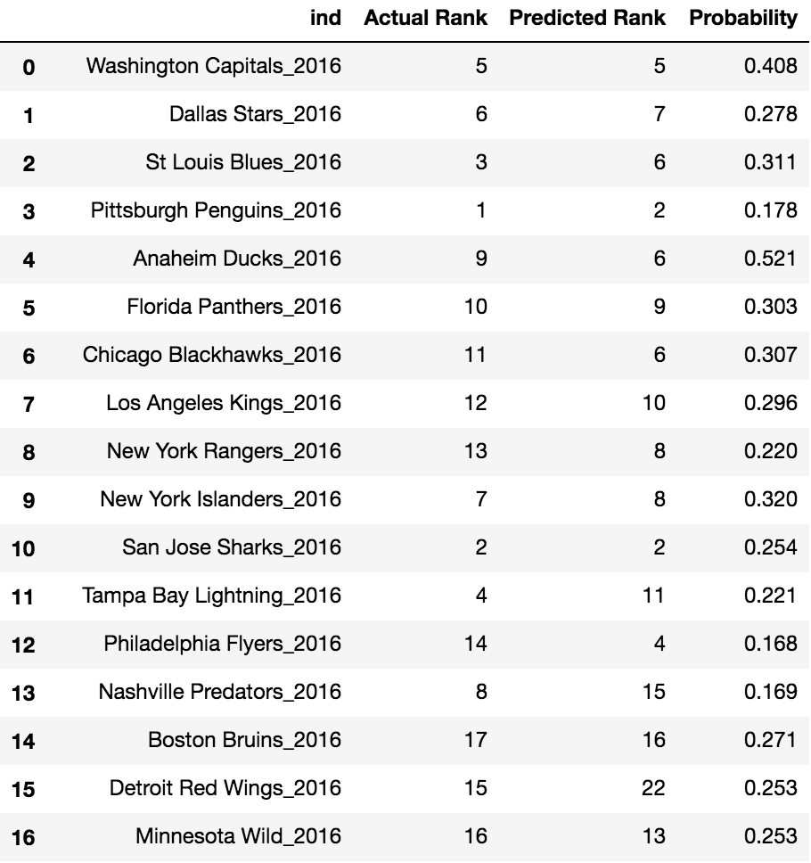
The Model Continued
While a model score of .12 sounds terrible, I’m actually slightly encouraged. While my predicted ranks are not spot on, they are close in many instances. For 2016, the model actually predicted both Stanley Cup finalists. Although, it did not accurately predict the winner.

Slide 12
Future Considerations
More feature engineering and creation of my own stats
Further tuning of the model and trying different multiclass classification models
Further interpretation of the predictive factors
I fully intend on continuing to tweak this model over the years

Slide 13
Questions?

